Slide 1
One problem.
One prompt.
One session.
Notes:
Don't dwell on the slide — they can read it. Use it as the bridge from last month to tonight.
Quick context first: last month's meetup.
Roughly 30% of the room were non-technical, here to get their heads around what Claude.ai actually is.
What they got were talks on matrix processing, model weights, non-determinism and Running out of tokens on a $200 subscription.
All fascinating if you're already in, but baffling If you're not,. People walked out with more questions than answers —
what tools can I build, what is a tools, what prompts do I use, where do I even start?
That's what tonight is about. I wanted to show — not tell — what Claude can actually do.
So I set myself a challenge: one real problem of my own, one four-hour session, using my £18-a-month subscription, starting with a single prompt. That's the talk.

Slide 2
CREDENTIALS
🖨
Printing Company Owner
(yes, I really did build an escape room)
Chris Lewis
🚪
Escape Room Owner & Creator
40+
Years
Electronics, Computing, Networking,
Cyber & Systems Analysis
💻
Competent in C, C++, Python & Scripting
🤖
AI: “Many” years building, training & integrating
Classifiers / local LLMs / ML code / GenAI models
UK Gov
Systems Engineer →
Head of Tactical Engineering
🔬
STEM Ambassador
Awards
UK Gov Director’s Award 2003.
Cyber Security Challenge UK ( Non-Profit Cyber Team of the Year 2021 )
👦
Code Club Volunteer - teaching 7-12 year olds
Notes:
Now the credentials — pick three or four, don't read them all. Forty years across electronics, computing, networking, cyber. UK Gov — systems engineer through to Head of Tactical Engineering, Director's Award along the way. Printing company. An actual escape room, with locks and lasers. Many years building and integrating AI — classifiers, local LLMs, GenAI.
I am a STEM Ambassador, so I’m kind of contractually obliged to stand up a witter on about tech.
And on Saturday mornings I teach seven to twelve year olds at Code Club in Longlevens. That last one is where this story starts.

Slide 3
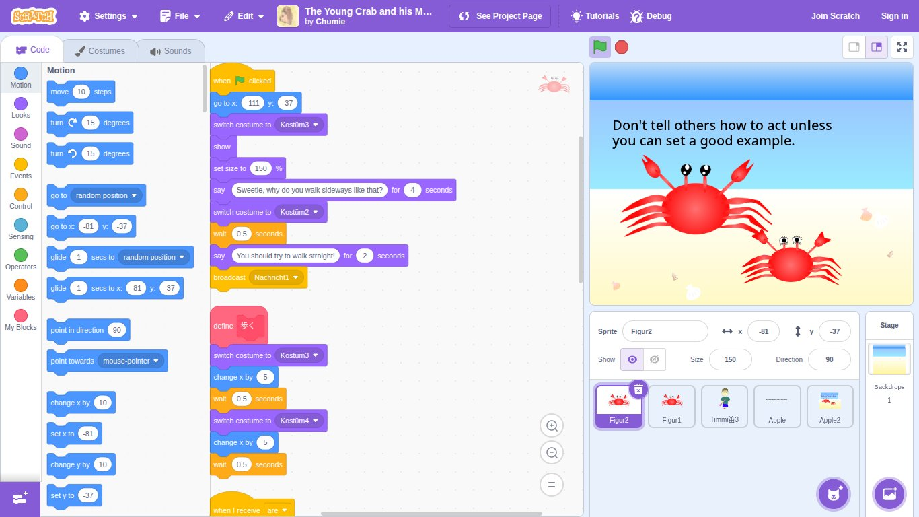
THE PROBLEM
A Typical Saturday Code Club
123M+
Children on Scratch worldwide
✓
Colourful, visual, immediate feedback
✓
Drag and drop - no syntax errors
✓
Taught in primary school
✓
Children learn logic without fear of failure
✓
Projects feel real - games, stories, animations
Scratch - the World’s introduction to coding
✓
Builds confidence before complexity
Notes:
Soften the pace here. This is the setup — the calm before the problem.
A bit of heritage worth knowing — and worth a sentence on stage if you have time.
The kids use Scratch to learn and develop their coding skills.
Scratch was built at MIT,. It launched in 2007. And it didn't come from nowhere — it stands on the shoulders of Logo, the language designed in the 1960s to teach children to think with computers, not just use them.
That lineage matters. Scratch isn't a toy bolted onto education — it's the latest chapter in sixty years of serious research into how children learn to code.
Today over 123 million children worldwide use Scratch. There's a reason. It's colourful. It's drag and drop, so there are no syntax errors to crush you. It's taught in primary school. Children learn logic without ever being afraid of failure — and the projects feel real. Games. Stories. Animations they can show their parents.
Scratch is the perfect first step into coding. It's the world's introduction to coding.
By the time a child leaves primary school they're flying.

Slide 4
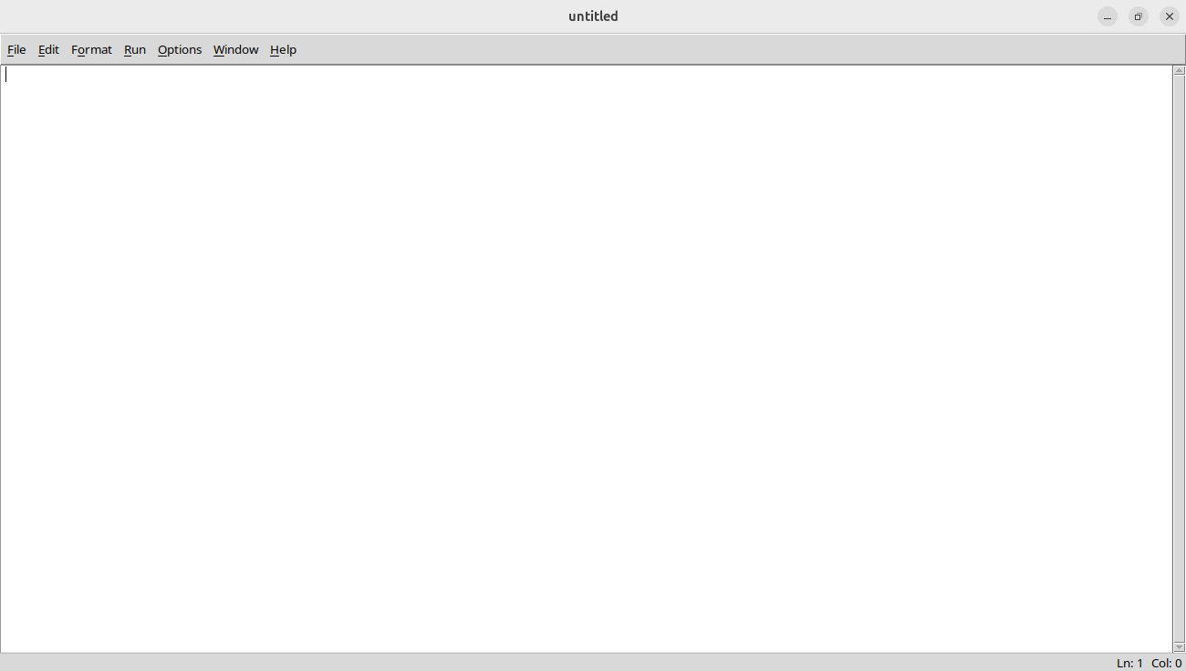
THE PROBLEM
Then Comes Python
90%
of schools use
Python for GCSE
-27%
Computing hours
in UK schools since 2015
✕
No colours, no blocks
✕
No visual feedback
✕
Error messages mean nothing
A child who was flying ten minutes ago is completely lost
✕
Confidence vanishes
✕
A huge chasm between Scratch and Python
Notes:
Change of tone. The room should feel the drop.
Then Secondary School and GCSE arrives.
90% of UK schools teach Python at GCSE — and computing hours in schools have dropped 47%. So there's less time to be taught, and the language got harder. A skills and confidence gap begins to open up.
No colours. No blocks. No visual feedback. Error messages that may as well be in Latin. The confidence that took years to build — gone in a lesson.
In fact, the Raspberry PI foundation have a series of tutorials for moving from Scratch to Python – Lesson 1 being ‘Print (“Hello”) on this same blanks page.
Pause. A child who was proficient in Scratch is now completely lost.
A chasm opens up in the confidence, and at just 11 years old, they decide that Computing is not for them.
I see this every year in my Code Club, and it’s the problem I wanted to try and solve.
So, I built a bridge

Slide 5
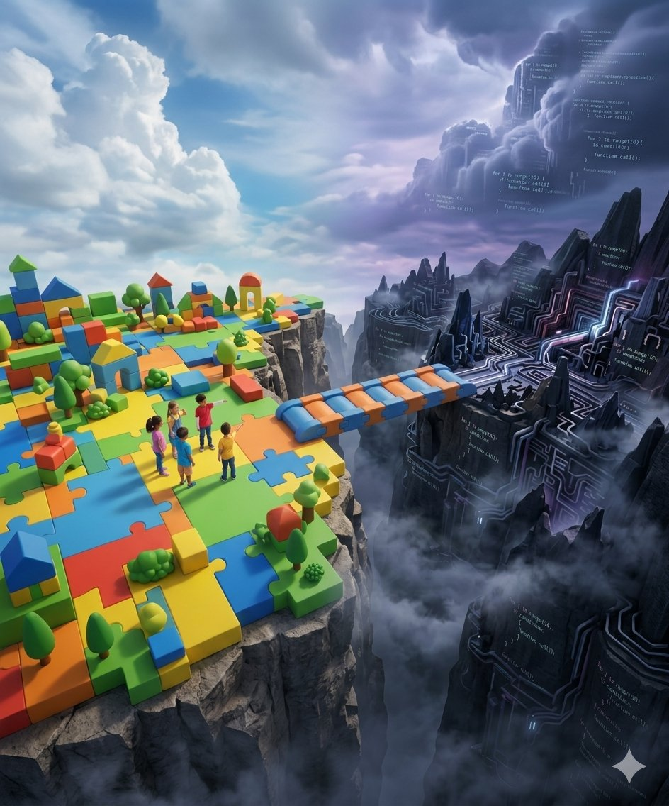
FROM AN IDEA TO WORKING APP
LLCodeBridge
IN ONE SESSION
Notes:
Land the title. Slow down. Let the room read the three lines for themselves.
From idea to working app — in one session. That's the claim. The rest of this talk is the proof.
Beat. Then move on.

Slide 6
THE APPROACH
My Initial Decisions
01
VS Code + Claude AI Extension
Claude embedded directly in the development environment - not a separate tab, not copy and paste. Aware of the files, aware of the context, right alongside the code.
02
Desktop App - Electron
Not a web server. Clean, self-contained, no dependencies to manage in a classroom. Electron is what VS Code itself is built on - cross-platform, well supported, native file dialogs.
03
No Python Installation Required
It had to just work. A child sits down, opens the app, and codes. No setup, no terminal, no system configuration.
04
Blockly as the Visual Layer
Scratch is built on Blockly — Google's open source JavaScript block framework. Using Blockly means the blocks look and feel familiar. Same logic, same visual language, just pointing somewhere new.
Two motivations: bringing something real to this forum - not a theory, a working product and I had a problem to solve.
Notes:
Before the prompt, four decisions. Walk through them in order — don't read the slide, talk to the numbers.
One: VS Code with the Claude extension. Claude embedded in the editor, aware of the files, aware of the context. Not a chat tab on a second monitor — right alongside the code.
Two: Electron desktop app. Not a web server. Self-contained, no dependencies in a classroom. VS Code itself is built on Electron — cross-platform, well supported, native file dialogs out of the box.
Three: no Python installation required. This was non-negotiable. A child sits down, opens the app, codes. No setup, no terminal, no system configuration.
Four: Blockly for the visual layer. Scratch is built on Blockly — Google’s now Raspberry Pi’s open source block framework. Same look, same logic, same drag-and-drop muscle memory the children already have. Just pointing somewhere new.
Two motivations driving all of this. One — I wanted to bring something real to this forum, not a theory, a working product. And two — I had an actual problem to solve.

Slide 7
THE PROMPT
One Paragraph. That’s it.
Plan an electron app that uses Google's Blockly to generate Python turtle graphics. The app should load and save projects, support functions, web HTML colours. There will be 3 windows which are all resizable and also have fullscreen toggle buttons. Blocks to include all turtle functions, array iteration, multiple turtles if possible.
First word:
PLAN
One paragraph
Result
Deliberate. Not build.
Think first.
No detailed technical spec.
Some useful suggestions.
Complete architecture
before a line of code
was written.
Notes:
This is the slide the non-technical half of the room came for. Slow down. Read the prompt out loud, exactly as it's written.
One paragraph. That's all I typed.
The most important word is the first one — PLAN. Not 'build', not 'code'. Plan. Think first.
No detailed spec. A few useful suggestions — three windows, resizable, fullscreen toggles, turtle functions, iteration, multiple turtles. The shape of what I wanted, not the implementation of it.
And the result of that one paragraph: a complete architecture before a single line of code was written. That's the lesson hidden in here — the quality of the first prompt sets the ceiling for everything that follows.

Slide 8
THE PLAN
What Claude Planned
🐍
Chose Skulpt
A Python interpreter that runs entirely in the browser. No python installation required.
I'd never heard of it - Claude found it, evaluated it, chose it.
🧱
Specified Blockly 10 + Split.js + Vanilla CSS
Lightweight libraries, no bloat. Deliberate, minimal choices that match the desktop-first requirement.
🖥
Designed the 3-Panel Layout
Workspace - Canvas - Code areas. All resizable. Fullscreen toggles on each. Mapped before any CSS or Javascript was written.
🐢
Catalogued 40+ Turtle Functions
Every motion, pen, screen, colour, and multi-turtle function identified and categorised into block types.
"This is using AI as a collaborator.” – Claude added this.
Notes:
Now show what 'plan' actually produced. Four bullets — take them one at a time.
Skulpt. A Python interpreter that runs entirely in the browser, no installation on the child's machine. I'd never heard of it. Claude found it, evaluated it, chose it. That's the bit to dwell on — it didn't ask me which Python runtime to use. It went and found the right one.
It specified the library stack — Blockly 10, Split.js, vanilla CSS. Lightweight, no bloat, no UI framework I didn't need. Deliberate, minimal choices that match the desktop-first requirement.
It designed the three-panel layout — workspace, canvas, code — all resizable, fullscreen toggles on each. Mapped before any CSS or JavaScript was written.
And it catalogued more than 40 turtle functions. Every motion, pen, screen, colour and multi-turtle function. Identified and categorised into block types — before any blocks existed.
Land the quote. This is using AI as a collaborator. Not as autocomplete, not as a search engine — as a colleague who plans with you.

Slide 9
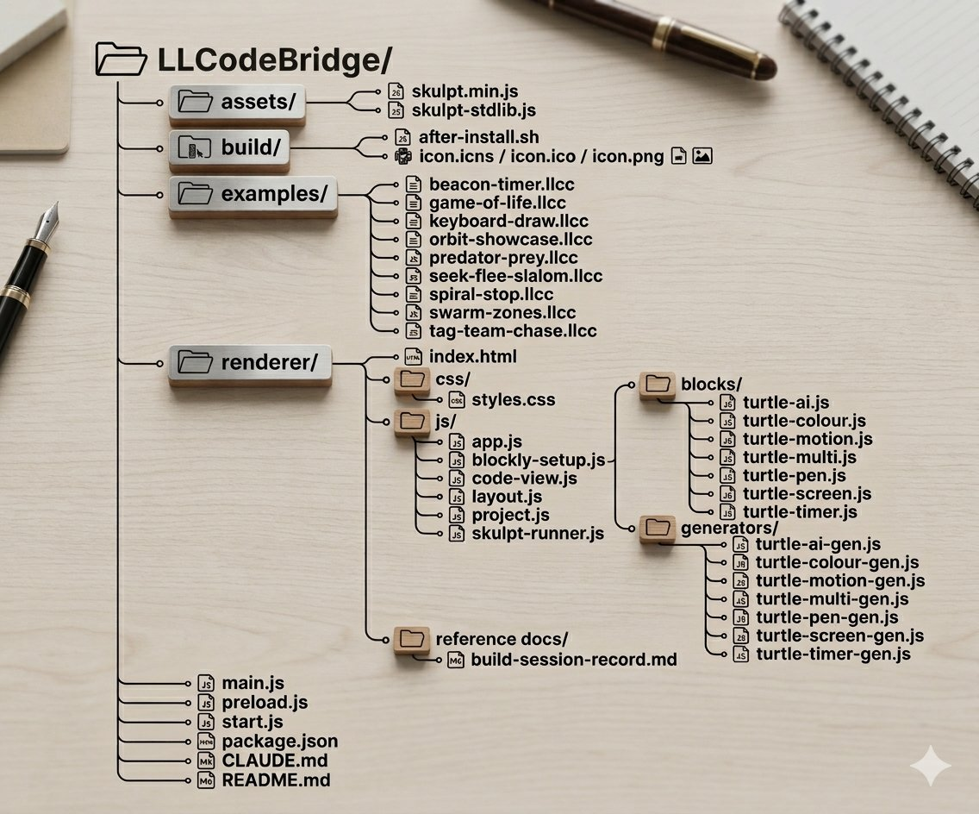
THE OUTPUT
Claude's Proposed Architecture
20+
5
Files Created
Block Categories
50
3
Custom Blocks
Target Architectures
I could have built this myself - if I had the time. But I'm a volunteer with a day job. Claude turned the hours I would have needed into minutes.
Notes:
Read the numbers out — they do the work. 20+ files. 5 block categories. 50 custom blocks. 3 target architectures.
All of that from one paragraph. All of that before a single line of code was committed. As it had access to my development environment, it knew to create a github repository to store and version control the project
The honest line —
I like to think could have built this myself, if I'd had the time. But I'm a volunteer with a day job. Claude turned the hours I would have needed into minutes. That's the value, plain and simple.

Slide 10
THE REALITY
When Things Went Wrong
It wasn’t all rainbows and unicorns. It hit walls. real, frustrating, technical walls, which we sorted together.
PROBLEM
ROOT CAUSE
SOLUTION
GPU crashed on Linux
Running without GPU support in environment
Added flags to disable GPU; configured app startup switches
Library API changed between versions
Newer version removed a method the code depended on
Detected at runtime, found replacement, adapted all affected code
Buttons silently did nothing
Security settings blocking native browser dialogs used internally
Overrode dialog system with custom DOM implementation
Not that it got things right first time - but that when it got things wrong, it figured out why.
Notes:
Change gear. This is the credibility slide — if you skip it, the rest sounds like a sales pitch.
It wasn't all rainbows and sunshine. It hit walls. Real, frustrating, technical walls.
Walk the table left to right. GPU crashed on Linux — environment had no GPU support.
Claude added startup flags to disable it. Sorted.
A library API had changed between versions — newer release removed a method the generated code was calling. Detected at runtime, found the replacement, updated every affected file.
Buttons silently doing nothing (Which I found ) — security settings blocking the native browser dialogs. Claude Overrode the dialog system with a custom DOM implementation.
Land the point. The impressive bit isn't that it got things right first time — it didn't. The impressive bit is that when it got things wrong, it figured out why and it had the tools to fix it.

Slide 11
THE RESULT
From Concept to Product
📦 Source Code Repository
💾 Releases
Created and maintained by Claude.
Claude wrote ALL files and ensured everything was kept up to date
Compiled executables - download and run without
Node.js or any build tools required.
github.com/thechrislewis/LLCodeBridge
github.com/thechrislewis/LLCodeBridge-releases
Single Prompt →
Architecture →
20+ Files →
Published App
That's not a prototype. That's a production pipeline.
Notes:
There's a source code repo — currently private, will be made public in due course. Claude wrote the README and all the descriptions in it.
There's a releases repo too, which I asked it to create for compiled executables to. Download and run. No Node.js, no build tools, nothing to install on the target machine if you do not want to.
Walk the chain along the bottom, slowly. Single prompt — architecture — 20+ files — published app.
That's not a prototype. That's a product.

Slide 12
LIVE DEMO
DEMO
"Code isn't magic - it's just logic in the correct order."
Notes:
Switch to the app. Don't narrate every click.
Demo arc — open the app, drag a few blocks, run, see the turtle move. Then a function. Then a colour. Then resize the panels and toggle fullscreen on one. Keep it under five minutes.
If something breaks, keep going. That's also a useful demo.
Land the quote on the way back to slides: code isn't magic — it's just instructions. Same for what Claude built. No magic. Just instructions, written well.

Slide 13
KEY BEHAVIOURS
What Claude did that was impressive
I instructed Claude to keep notes throughout. This slide is Claude’s opinion.
📋
Planned Before Coding
🔍
Adaptive Problem Solving
Designed the architecture upfront. No rushing to write code.
Traced issues methodically. No guessing.
📌
Version-Aware
✅
Systematic
Checked actual API behaviour at runtime rather than assuming docs were correct.
Maintained a to-do list tracking all implementation steps. Built deployment tools for manual use
🎯
No Unnecessary Abstraction
🔄
Self-Correcting Without Prompting
Vanilla CSS, no UI framework, no bundler. Exactly what was needed, nothing more.
Caught its own mistakes – out of date APIs, wrong arguments - and fixed them.
Notes:
This is the takeaways slide for the non-technical half of the room. They came to understand what Claude does well. This is the answer.
Quick context — I asked Claude to keep notes throughout the session. That document became the backbone of this talk.
So these aren't my observations bolted on afterwards — they're Claude's own behaviour, documented as it happened.
Don't read all six. Pick three that resonate with the room.
Planned before coding — designed the architecture upfront. No rushing to write code.
Adaptive problem solving — traced issues methodically. No guessing.
Version-aware — checked actual API behaviour at runtime rather than trusting documentation that might be out of date.
Systematic — maintained a to-do list tracking every implementation step. Built its own deployment tools, which I could also use
No unnecessary abstraction — vanilla CSS, no whizzy latest framework, no bloat. Exactly what was needed, nothing more.
And self-correcting without prompting — caught its own mistakes, out-of-date APIs, wrong arguments, and fixed them before I even noticed.
That last one is the headline. That's the difference between autocomplete and a collaborator.

Slide 14
HONEST REFLECTION
Impressive ≠ Production Ready
Staying in the driving seat after the session ends — not just during it.
🔒
Security Review
Skulpt runs Python in the browser. Needs review of execution scope and whether project files could do anything unexpected on load.
🖥
Cross-Platform Testing
The app works, but structured testing across Windows, Mac and Linux not yet done. A GPU issue on Linux surfaced during the session.
🔎
Code Audit
20+ files generated in one session. Functionally tested - not yet audited line by line by a human engineer - ( Me )
📤
Distribution & Updates
Executable is published. No update mechanism yet - users must re-download when fixes are made.
Widen Linux distributions beyond ubuntu and Raspberry Pi
♿
Accessibility
Colour contrast, keyboard navigation, font control missing
Notes:
Slow this slide down. This is the slide that buys you credibility — the room is waiting to hear what you got wrong, or what you haven't done yet.
Impressive doesn't equal production ready. Four hours got me a working app. It didn't get me a finished product. And that's the lesson — staying in the driving seat after the session ends, not just during it.
Five honest gaps.
Security review — Skulpt runs Python in the browser. Execution scope needs proper review. So does the question of what a malicious project file could do on load.
Cross-platform testing — built and tested as I went, but structured testing across Windows, Mac and Linux is not yet done. A GPU issue surfaced on Linux during the session — that won't be the last one.
Code audit — 20+ files generated in a single session. Functionally tested. Not yet line-by-line audited by a human engineer.
Distribution — the executable is published. No update mechanism yet. Users have to re-download when fixes ship. Fine for a demo, not fine for a tool real classrooms depend on.
Accessibility — colour contrast, keyboard navigation, screen reader compatibility. None of it tested.
Land the honesty. This is what 'impressive' actually looks like — useful, real, and still a long way from done.

Slide 15
LIVE DEMO
DEMO
V2.0
"What happened after the 1st session ended."
Notes:
Second demo. This is the answer to 'so what happened after the four hours?' — v2
But I didn't stop there. I let the kids use it. Watched how they used it, what they reached for, what broke. The other volunteers also suggested some changes. So I used a few more spare hours over a few days to implement those changes — and created v2.0.
Show two or three things that got better since the first session. Pick the ones that visibly improve the experience — don't get stuck explaining a refactor nobody can see.

Slide 16
THE JOURNEY
From Chasm to Bridge
The Python Chasm
Now when a child stands at the edge of the Python chasm - looking across it, wondering how on earth they're going to get to the other side - they'll have a bridge.
Not a helicopter. Not a shortcut. A bridge. They still have to cross, they still have to learn. But now they have something solid under their feet while they find their way.
I’ve shown what you can do with one prompt in one session…
What problem do YOU have that's been sitting in your head, half-formed, waiting for the right moment?
Notes:
Slow right down. This is the close. Don't rush it.
Remember the chasm from earlier — the child flying in Scratch, then completely lost in Python. That was the problem.
Now when a child stands at the edge of that chasm, looking across, wondering how on earth they're going to get to the other side — they'll have a bridge.
Not a helicopter. Not a shortcut. A bridge. They still have to cross. They still have to learn.
But now they have something solid under their feet while they find their way.
Beat. Then the line that does the heavy lifting — one session, one prompt, one working application.
And then turn it back on the room. What problem do YOU have that's been sitting in your head, half-formed, waiting for the right moment?

Slide 17
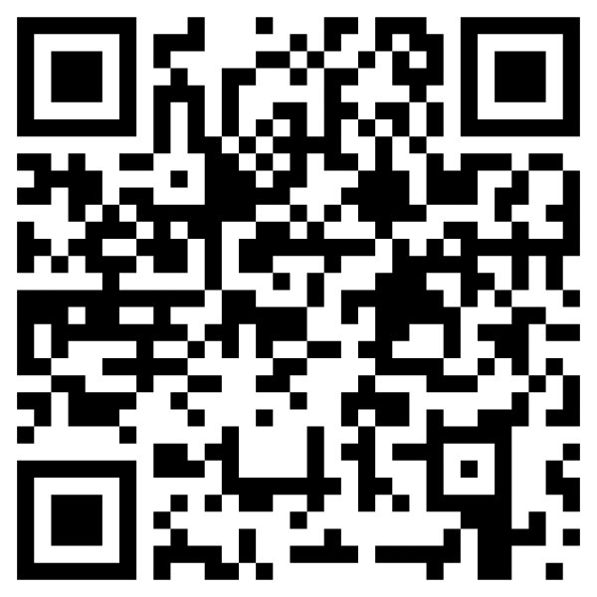
THANK YOU
Questions?
Chris Lewis
github.com/thechrislewis
linkedin.com/in/chrislewis64
Scan to download LLCodeBridge
Notes:
Leave this slide up for the whole Q&A. The QR code does the work — anyone in the room can download LLCodeBridge before they leave.
Open with a simple invitation: questions, comments, war stories — all welcome. Technical or not.
If the room is quiet, prompt with one of your own. Common ones to be ready for: how much did it really cost? (£18 for the month, plus my time.) Could I have done this without 40 years of background? (Honest answer — the background helped me ask the right things, but the prompt itself is one paragraph any of you could write.) What about hallucinations? (Yes, it happens — and the version-aware behaviour on slide 13 is part of how it's caught.)
Thank them properly on the way out.

